Slide 1

Debottam Chatterjee 2205464
Kasutabh Shit 2205131
Piyush
Pratyush Singh

Slide 2
Description of the Dataset
Type:
1) Contains CT (Computed Tomography) chest images captured from real medical cases.
2) Each image represents cross-sectional scans of the lungs used for diagnostic study.
Purpose:
1) Specifically created for research in lung cancer detection and classification.
2) Enables training and evaluation of Machine Learning and Deep Learning models (especially CNNs) for identifying cancerous vs. normal tissue.
Structure:
1) Dataset is organized into three main folders — Train, Test, and Validation — to facilitate model development and evaluation.
2) Each folder contains subfolders representing four distinct classes: Adenocarcinoma, Large Cell Carcinoma, Squamous Cell Carcinoma, Normal (Healthy)
3) These labeled categories allow supervised learning for multi-class image classification.

Slide 3
Key Features & Usage Considerations:
A) Key Features:
1) Multi-class Dataset:
a) Contains CT images from four categories – Adenocarcinoma, Large Cell Carcinoma, Squamous Cell Carcinoma, and Normal (Healthy) cases.
b) Enables supervised learning for multi-class classification tasks.
2) Pre-split Data:
a) Dataset already divided into Training, Validation, and Testing sets.
b) Helps streamline model training and performance evaluation.
B) Use Cases:
1) Train Convolutional Neural Networks (CNNs) or Vision Transformer models for lung cancer image classification.
2) Benchmark the performance of different image recognition algorithms.
3) Perform feature extraction and transfer learning for medical imaging research.
C) Considerations:
1) Ensure ethical use and maintain patient data privacy — all images must remain de-identified.
2) Check for class imbalance to avoid biased model training.
3) Apply image preprocessing (resizing, normalization, augmentation) for consistent input quality.
4) Evaluate model performance using metrics like Accuracy, Precision, Recall, F1-Score, and AUC (ROC Curve).
D) Goal: Develop reliable AI models that can assist radiologists in early and accurate detection of lung cancer from CT scans.

Slide 4
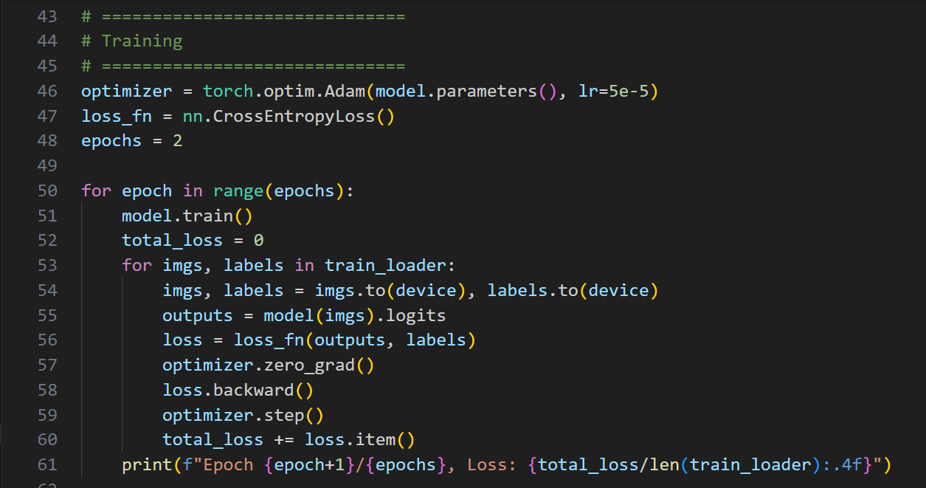
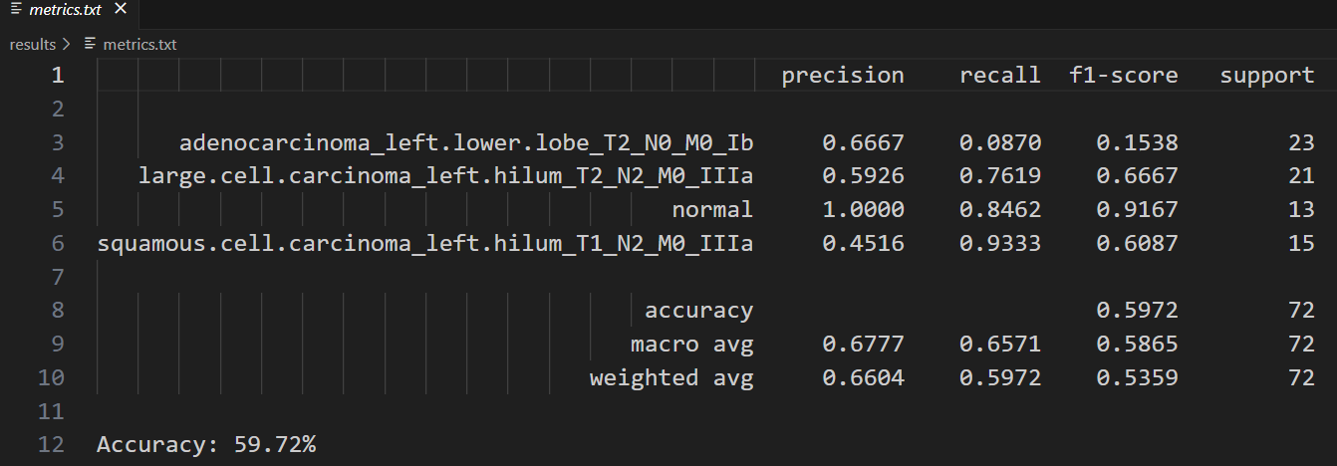
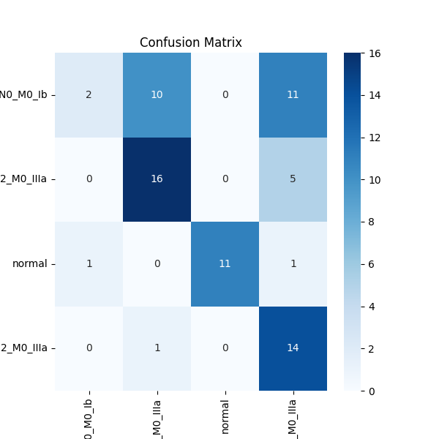
Description of the Model
We fine-tune a pretrained Vision Transformer (ViT) to classify lung images into four categories. The dataset is loaded using PyTorch’s `ImageFolder` and preprocessed with resizing, normalization, and tensor conversion via `ViTFeatureExtractor`. A pretrained `google/vit-base-patch16-224-in21k` model is initialized with its output layer adapted for four classes, then trained for two epochs using the Adam optimizer and cross-entropy loss. The trained model is evaluated on the validation set to compute accuracy, generate a classification report, and plot a confusion matrix. Finally, the model weights, evaluation metrics, and confusion matrix are saved for analysis and reporting.
→
Results of all the Performance Metrics of all the 4 classes
↓
Code Snippet of ViT Transformer
Confusion Matrix

Slide 5
ViT Model Description
To be done at LAST

Slide 6
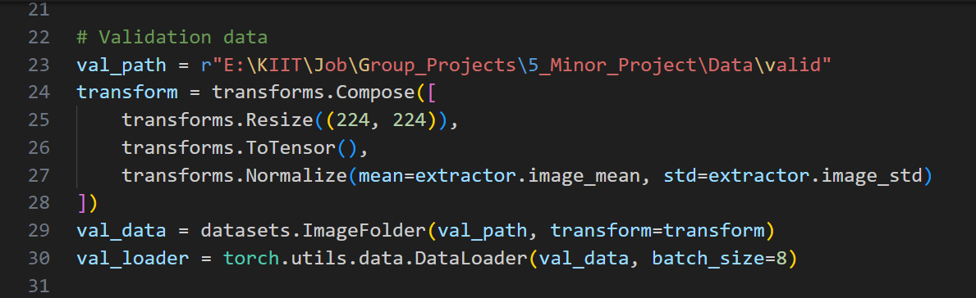
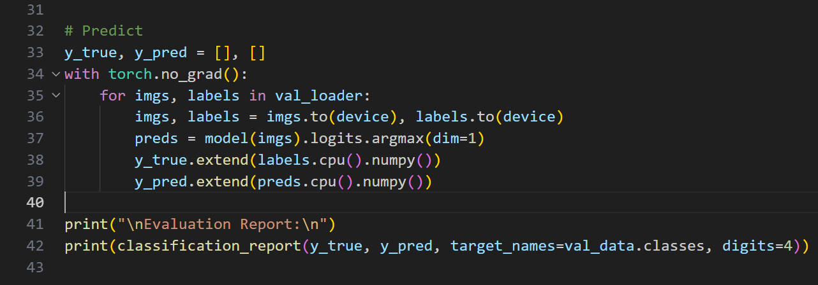
Evaluation of Fine-Tuned Vision Transformer (ViT) for Lung Image Classification: We load a fine-tuned Vision Transformer (ViT) model to classify lung images into four categories. The model weights are loaded from a saved checkpoint and moved to the appropriate device (CPU/GPU). Validation images are preprocessed with resizing, normalization, and tensor conversion using ViTFeatureExtractor. The model generates predictions on the validation set, and the results are used to compute a detailed classification report. Finally, the evaluation metrics are printed to assess model performance.
&
Testing Process is performed
Evaluation Metrics are calculated

Slide 7
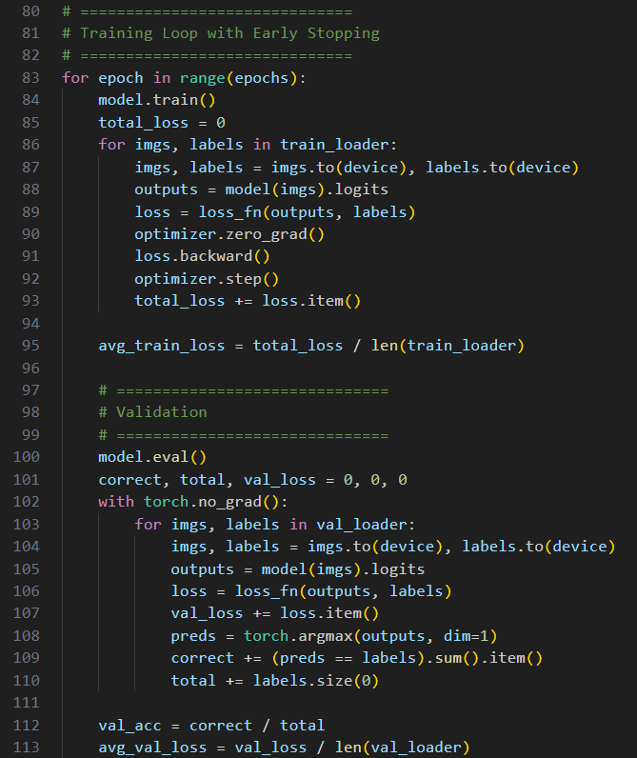
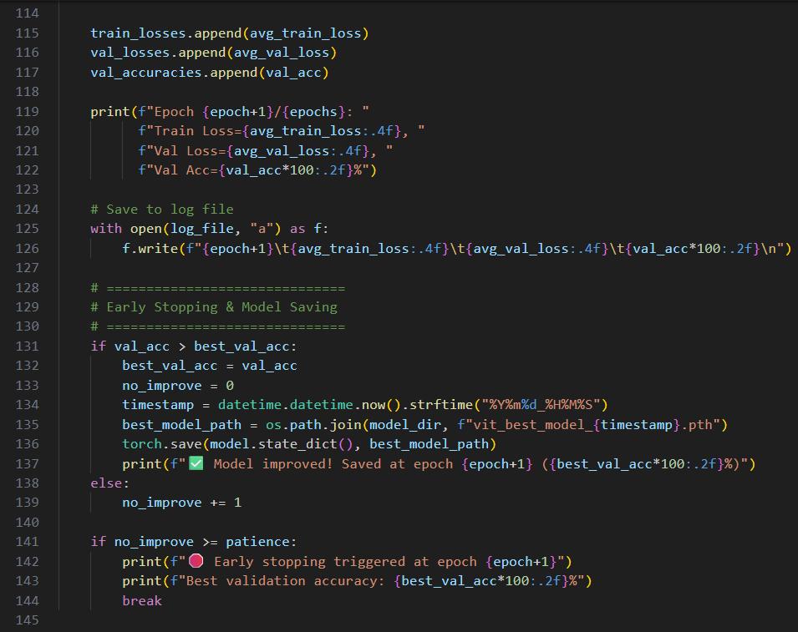
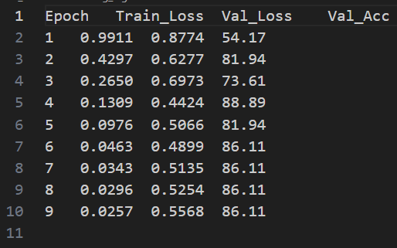
Fine-Tuning Vision Transformer (ViT) for Lung Image Classification with Early Stopping: This code fine-tunes a pretrained ViT to classify lung images into four categories, with datasets preprocessed using `ViTImageProcessor`. The model trains with early stopping based on validation accuracy, saving the best weights and logging losses. After training, it evaluates the model, generates a classification report, confusion matrix, and plots training/validation curves for analysis. All results, metrics, and the best model are saved for further use and reporting.
&
→
Training till 10 epochs
(note that after 6 epochs the accuracy remains the same)
Code Snippet for the above

Slide 8
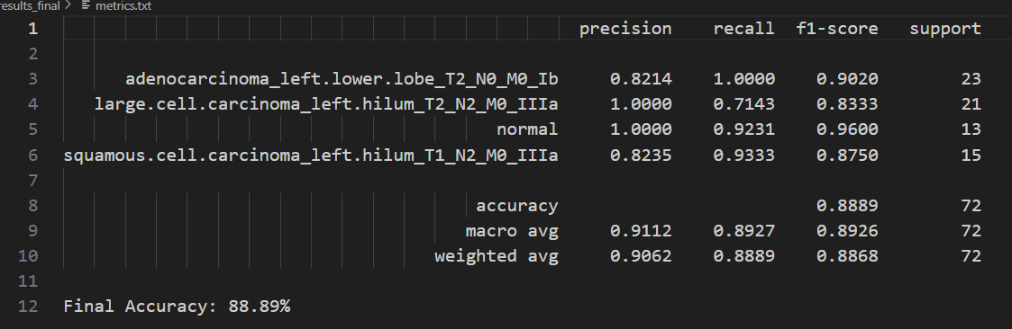
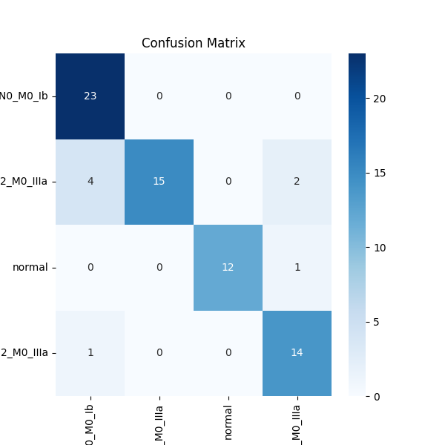
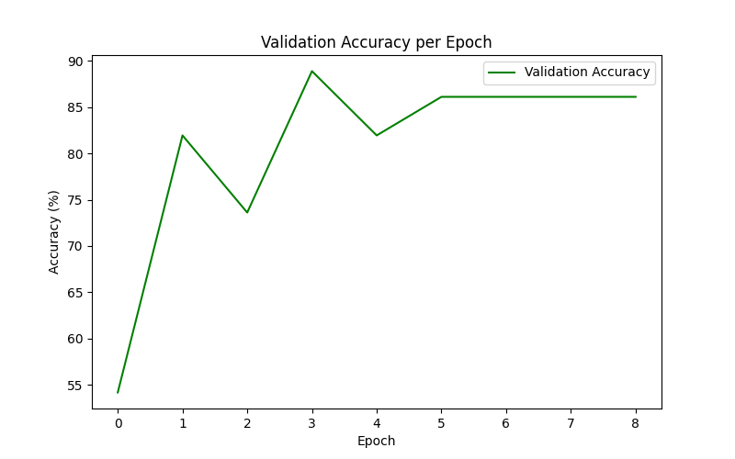
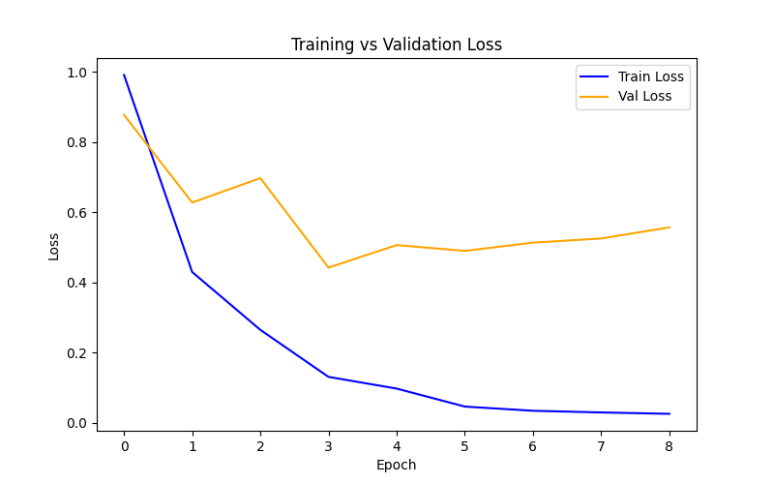
→
Evaluation Metrics Calculated
Confusion Matrix
↓
←
Graph of Validation Accuracy per Epoch
Graph of Training vs Validation Loss

Slide 9
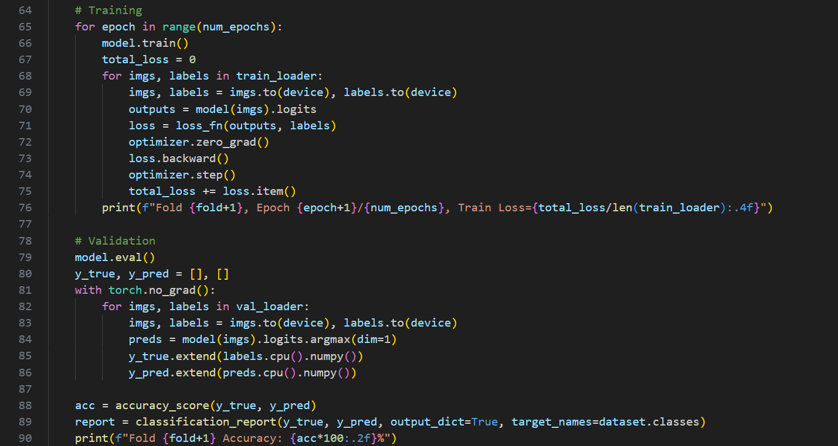
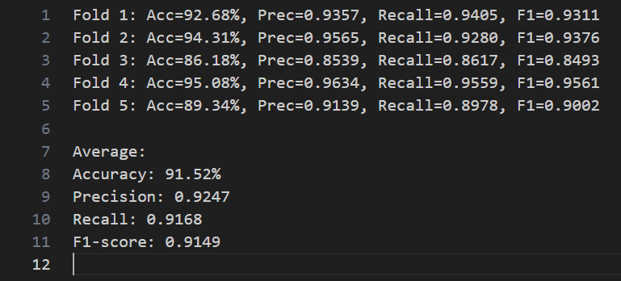
K-Fold Cross-Validation for Fine-Tuning Vision Transformer (ViT) on Lung Images: This code fine-tunes a pretrained ViT to classify lung images using K-Fold cross-validation, training the model on each fold and evaluating it on the corresponding validation subset. Fold-wise metrics (accuracy, precision, recall, F1-score) are computed, averaged across all folds, and saved for robust performance assessment.
→
Code Snippet of K-Fold Cross Validation
Evaluation Metrics

Slide 10
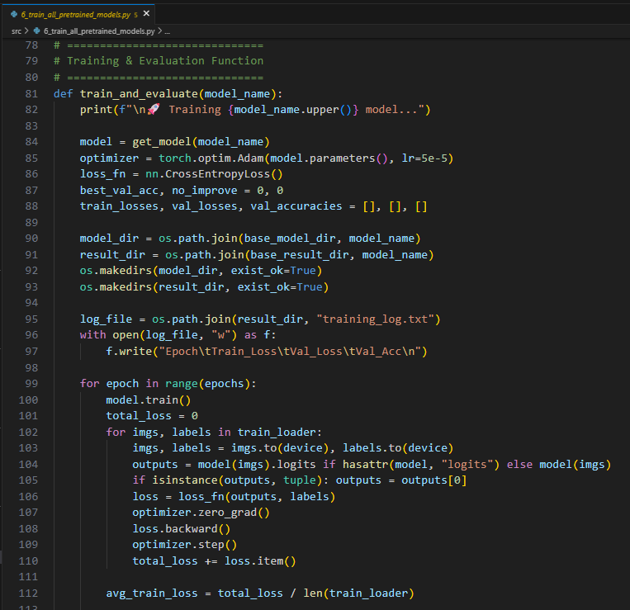
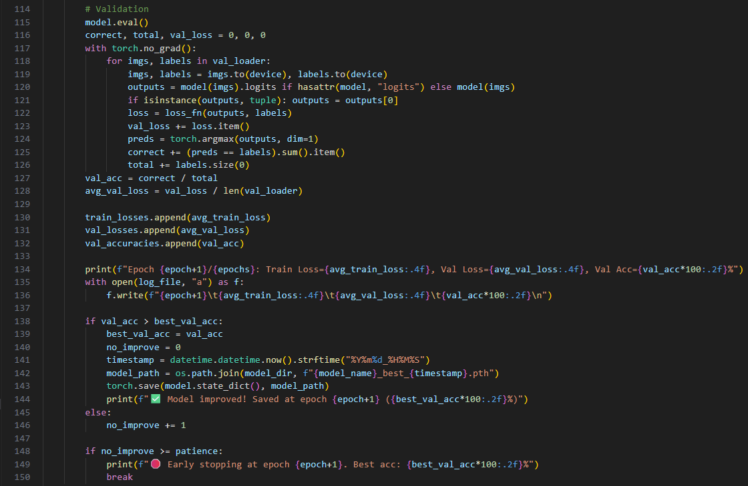
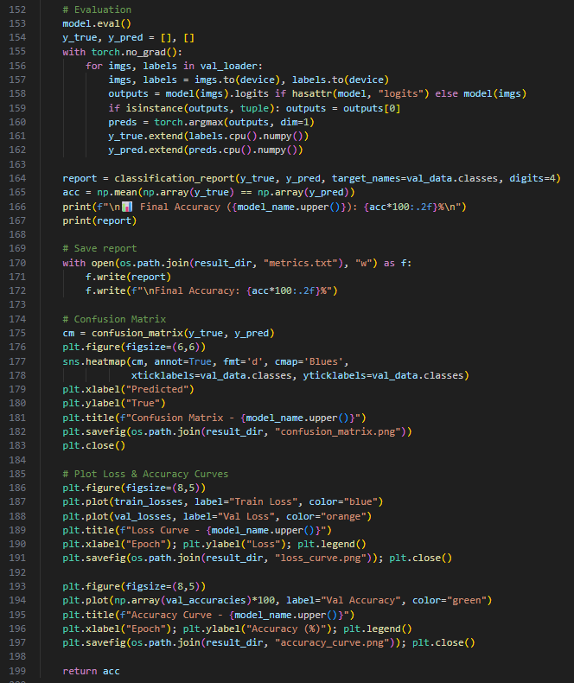
Comparative Analysis of CNN and Transformer Models for Image Classification: This Python script trains and evaluates six deep learning models — VGG16, ResNet50, DenseNet121, EfficientNet-B0, ViT, and Swin Transformer — on a 4-class image classification dataset. It performs training, validation, early stopping, and saves performance reports, accuracy/loss curves, and confusion matrices for each model. Finally, it summarizes all model accuracies into a single results file for comparison.
&
&
Pseudo Code of the Comperative Analysis of CNN and Transformer Models

Slide 11
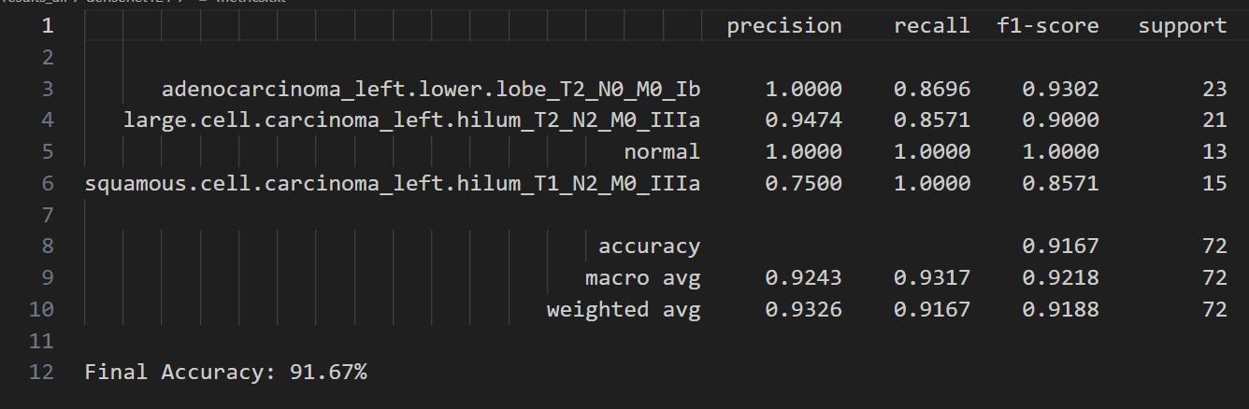
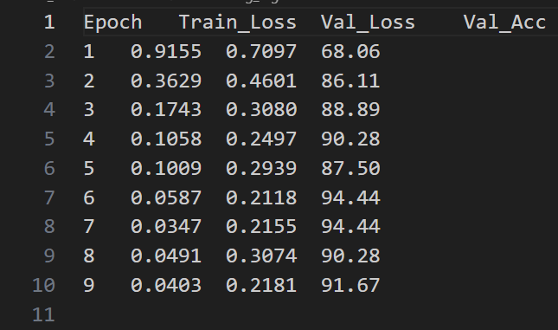
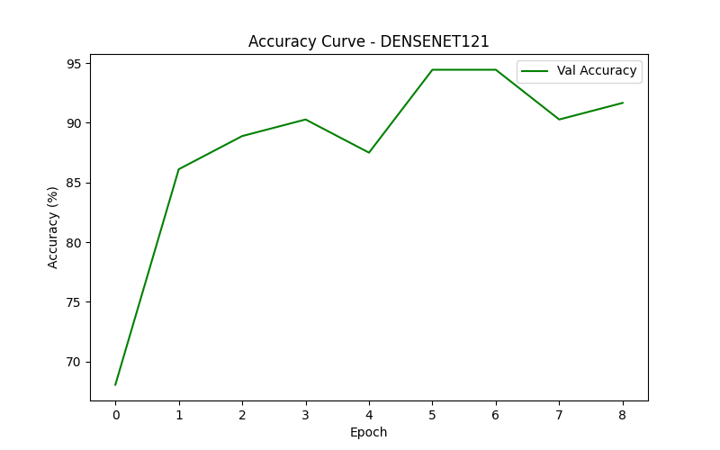
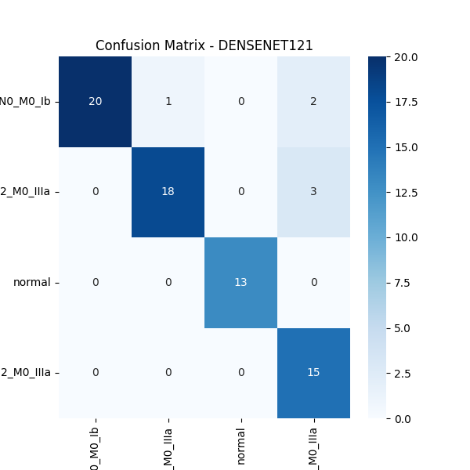
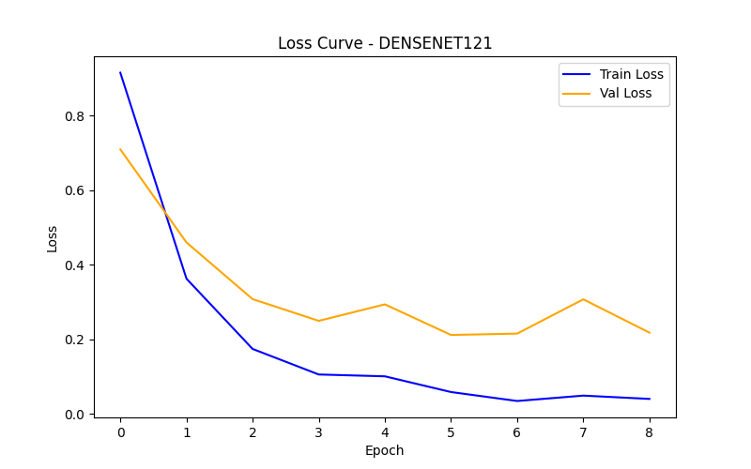
For densenet121
→
↓
→
Performance Metrics of desnet121
Training till 10 epochs
Accuracy Curve for desnet121
↓
←
←
Loss Curve for desnet121
Confusion Matrix for desnet121

Slide 12
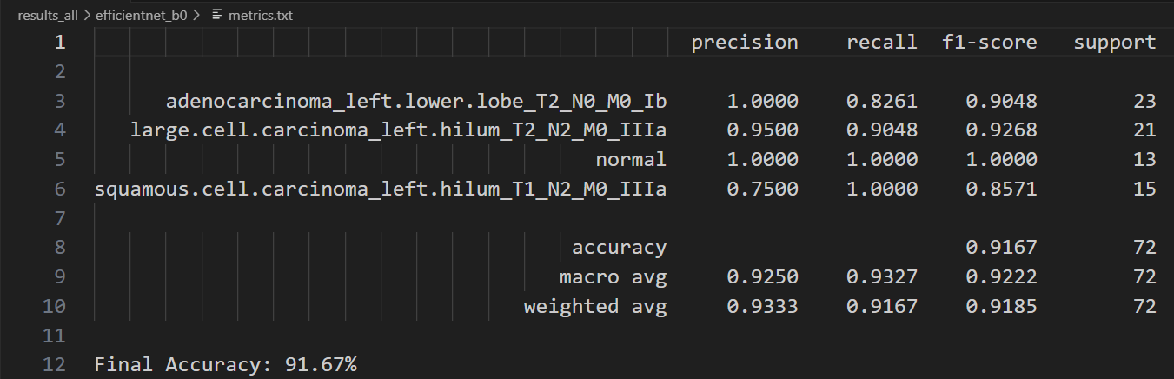
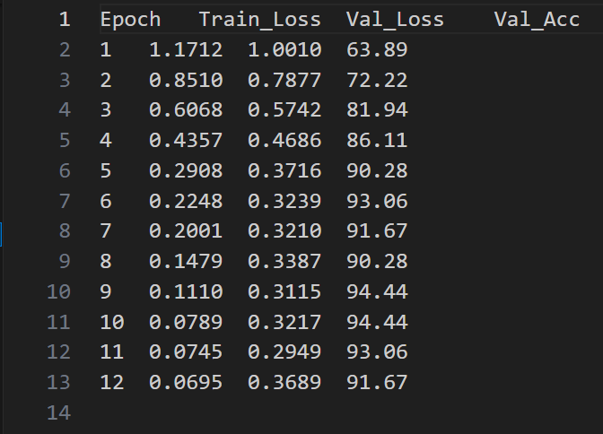
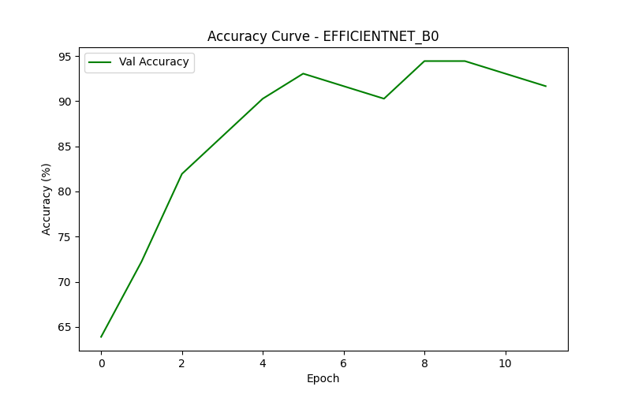
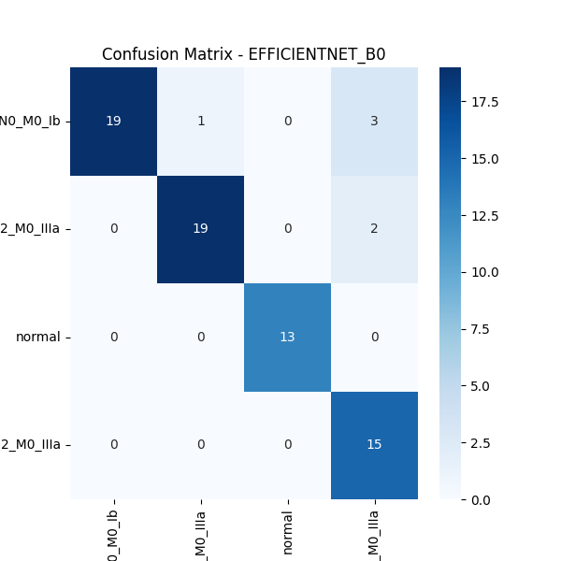
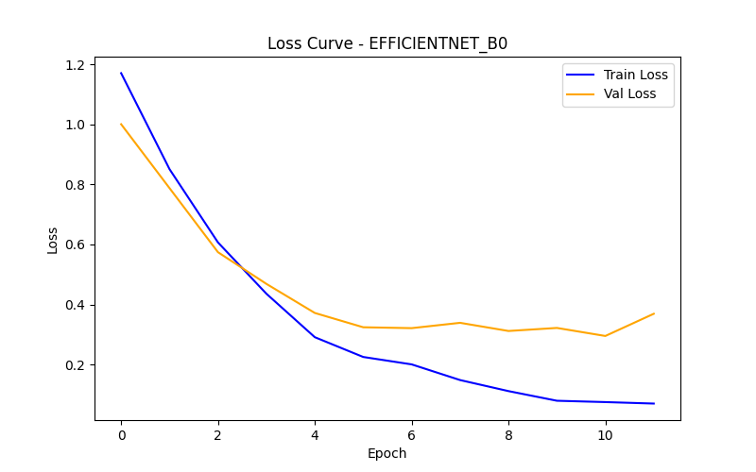
For efficientnet_b0
→
→
↓
Performance Metrics of efficientnet_b0
Training for 12 epochs
Accuracy Curve for efficientnet_b0
←
↓
←
Confusion Matrix for efficientnet_b0
Loss Curve for efficientnet_b0

Slide 13
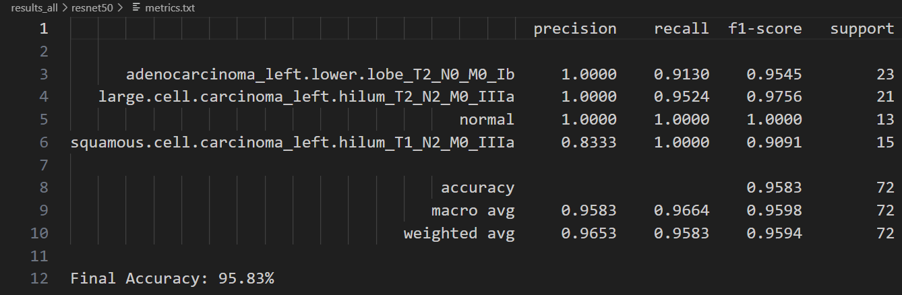
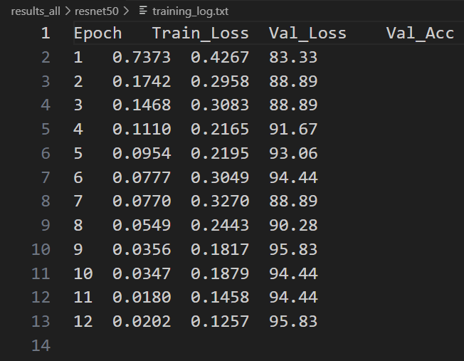
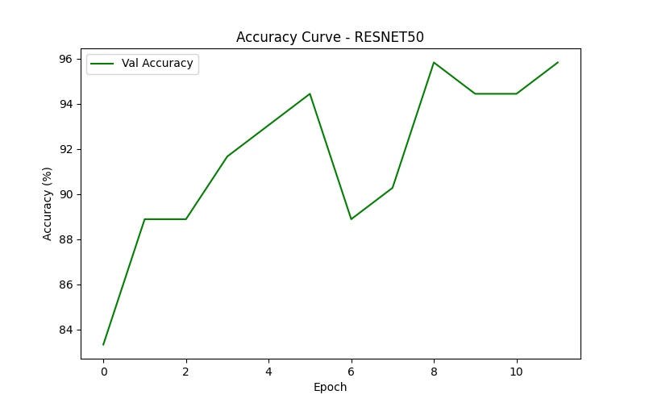
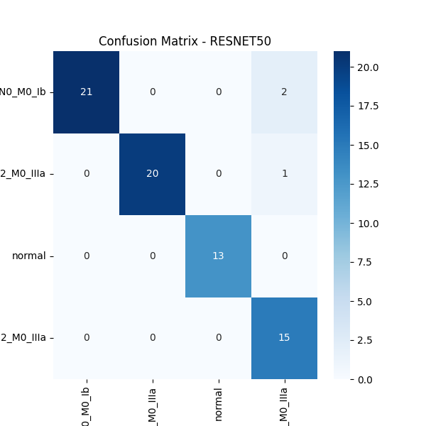
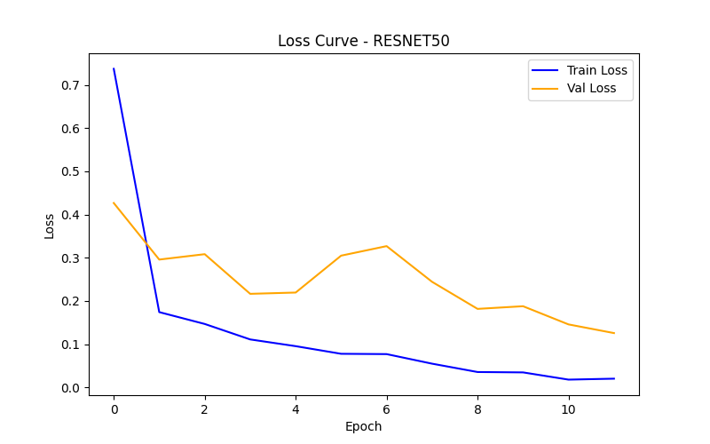
For resnet50
→
→
↓
Performance Metrics of resnet50
Training till 12 epochs
Accuracy Curve of resnet50
←
↓
←
Confusion Matrix of resnet50
Loss Curve of resnet50

Slide 14
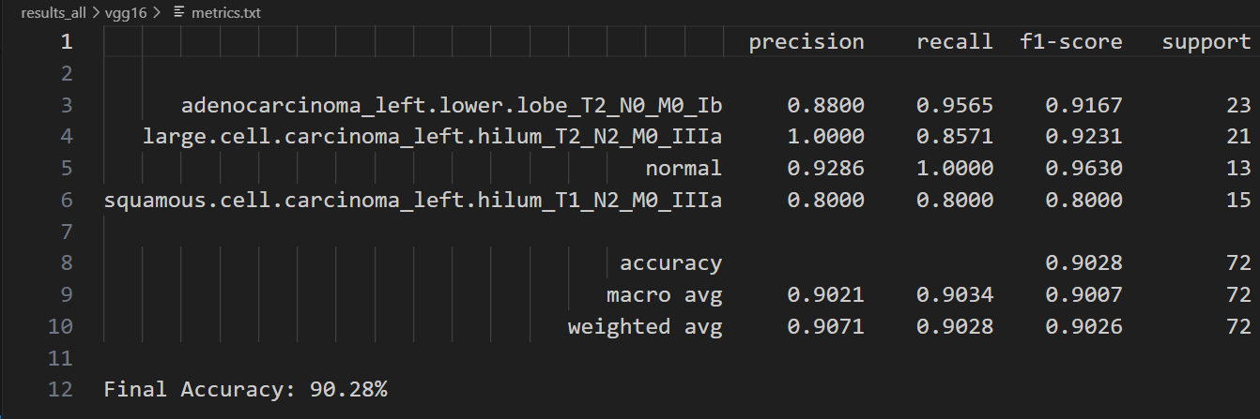
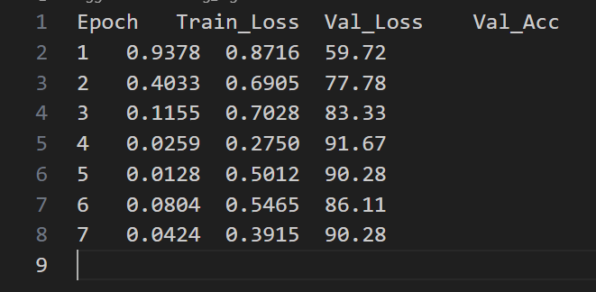
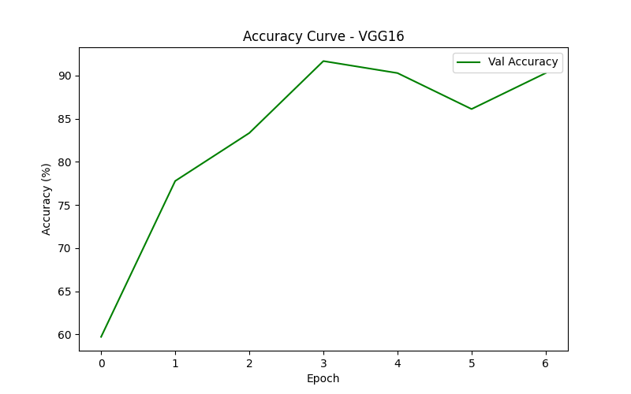
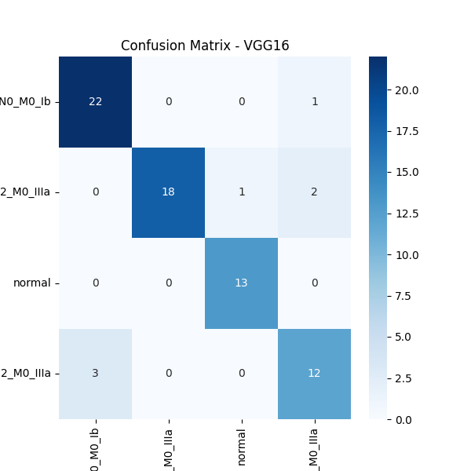
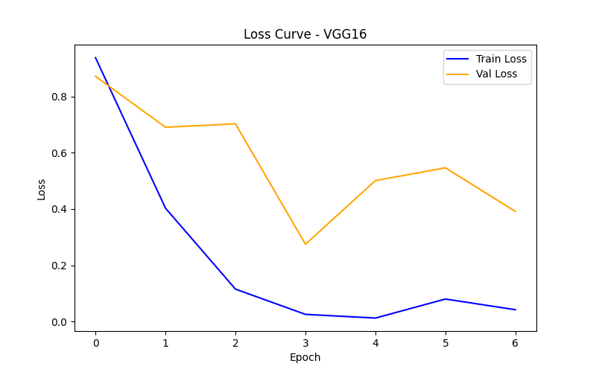
For vgg16
→
→
↓
Performance Metrics of vgg16
Training till 7 epochs
Acccuracy Curve for vgg16
↓
←
←
Loss Curve for vgg16
Confusion Matrix for vgg16

